Slide 1




Introduction to Nike Database Analysis
This presentation will provide an in-depth analysis of Nike's database, uncovering key insights and trends that can inform strategic decision-making. We will explore several queries to gain a comprehensive understanding of the company's performance and identify opportunities for growth.
by Lala Khan

Slide 2
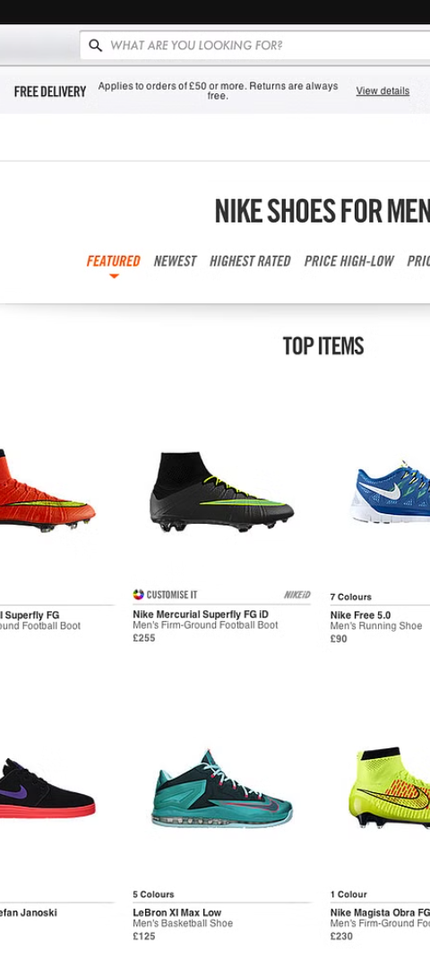
Query 1: _____
Product Trends
Customer Preferences
Analyze the most popular product categories, best-selling items, and emerging trends to inform product development and marketing strategies.
Identify customer preferences based on purchase data, demographic information, and behavioral patterns to improve targeted marketing and personalization.
Supply Chain Optimization
Examine inventory levels, production efficiency, and logistics to identify areas for improvement and ensure a smooth, responsive supply chain.

Slide 3
Query 2: _____
Campaign Performance
Customer Engagement
Brand Sentiment
Monitor brand perception, customer reviews, and social media sentiment to identify areas for improvement and strengthen Nike's reputation.
Evaluate the effectiveness of marketing campaigns across different channels, including social media, digital advertising, and traditional media.
Analyze customer interactions, such as website visits, email open rates, and social media engagement, to optimize marketing strategies and improve customer experience.

Slide 4
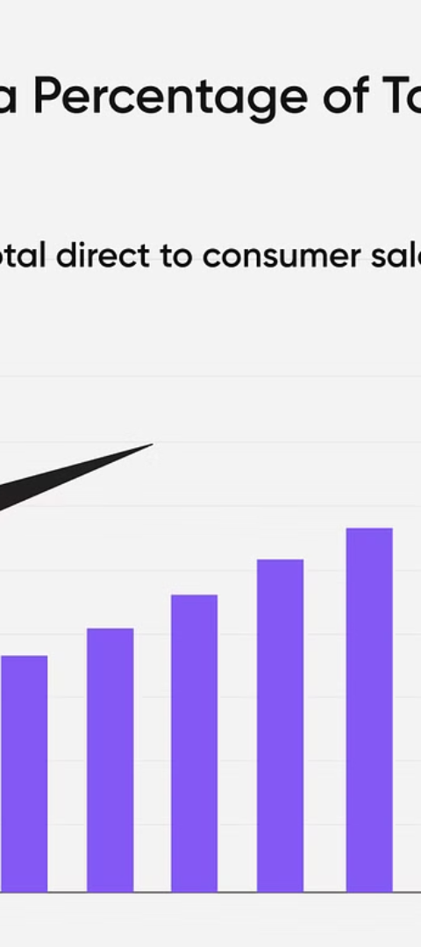
Query 3: _____
1
Regional Sales Trends
Examine sales performance across different geographical regions to identify growth opportunities and address any regional disparities.
2
Channel Performance
Analyze sales data across various channels, such as retail stores, e-commerce, and wholesale, to optimize the omnichannel strategy.
3
Seasonal Variations
Identify seasonal patterns in sales to improve inventory management, production planning, and targeted marketing campaigns.

Slide 5
Query 4: _____
1
Revenue Growth
2
Gross Margins
Analyze the company's revenue trends, including year-over-year growth, to identify drivers of financial performance.
Evaluate the company's cost structure and pricing strategies to optimize profitability and identify areas for improvement.
3
Inventory Management
4
Cash Flow Analysis
Assess the efficiency of inventory management, including inventory turnover and stockout rates, to improve working capital and supply chain operations.
Examine the company's cash flow patterns to ensure financial stability and identify opportunities for strategic investments or cost reductions.

Slide 6



Query 5: _____
Product Innovation
Technological Advancements
Sustainability Initiatives
Analyze the impact of new product introductions, including their sales performance and market share, to guide future innovation efforts.
Evaluate the adoption and impact of new technologies, such as smart fabrics, digital platforms, and automation, to enhance the company's competitive advantage.
Assess the progress and impact of sustainability-focused initiatives, such as the use of recycled materials and energy-efficient manufacturing, to align with emerging consumer preferences.

Slide 7

Key Insights and Findings
1
Trends and Opportunities
2
Competitive Advantages
3
Operational Efficiency
Summarize the key insights and trends uncovered through the database analysis, highlighting areas of growth, potential risks, and strategic opportunities.
Identify the company's core strengths and competitive advantages, such as strong brand recognition, innovative product development, and effective marketing strategies.
Discuss opportunities to improve operational efficiency, including supply chain optimization, inventory management, and cost control measures.

Slide 8

Conclusion and Next Steps
In conclusion, the in-depth analysis of Nike's database has revealed valuable insights that can inform strategic decision-making and guide the company's future direction. Based on these findings, the next steps will involve developing a comprehensive action plan to capitalize on the identified opportunities, address any challenges, and ensure Nike's continued growth and market leadership.

